Slide 1


SMART INDIA HACKATHON 2025
Alumni Connect
Problem Statement ID – 25017
Problem Statement Title- Digital Platform
for Centralized Alumni Data Management and Engagement
Theme- Education & Community Development
PS Category- Software
Team ID-
Team Name – Tech Army

Slide 2
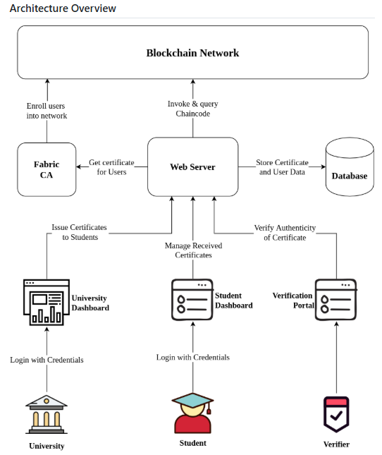
IDEA TITLE: Alumni Connect
Tech Army
Proposed Solution
Centralized platform for alumni data, career networking, and mentorship.
Blockchain ensures secure credentials and transparent donation tracking.
AI matches students with mentors, internships, and career paths.
Real-time mentor–mentee engagement and verified achievement sharing.
Builds alumni, student, institution ecosystem.
Mentor mentee discussion & career matching.
Drives fundraising, alumni recognition, and long-term growth.

Slide 3
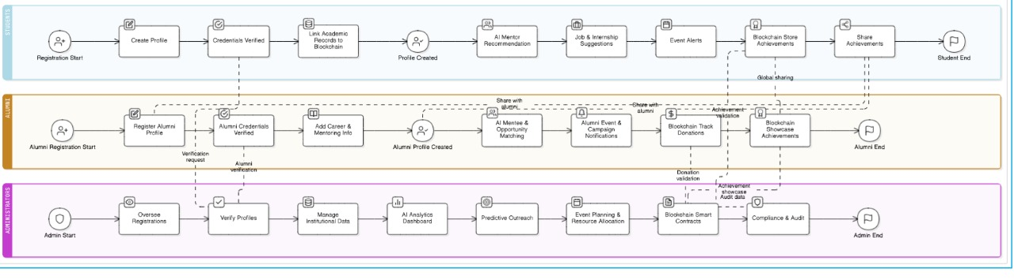
TECHNICAL APPROACH
Tech Army
Technologies Used
Frontend: HTML, CSS, JavaScript,React.js
Backend: Node.js, Express.js
Database: MongoDB /PostGREs
Blockchain: Hyperledger for donations + certificates
Cloud: AWS
Mobile: React Native,Kotlin, Flutter
Methodology
Alumni registration : Profile creation (verified by institution).
AI-based recommendations (mentors, jobs, events).
Blockchain ensures trust in donations & achievements.

Slide 4
FEASIBILITY AND VIABILITY
Tech Army
Feasibility
Scalable cloud infrastructure supports millions of alumni and students.
Secure role-based access ensures tailored experiences for Alumni and Students.
Open-source blockchain frameworks reduce operational costs and enable long-term scalability.
Data privacy compliance aligned with blockchain and encryption.
API-based integration with existing institutional systems .
Strategies to Overcome
Hybrid Access Channels: Mobile App + Web Portal.
Trust-building Incentives: Verified credentials, career matching, alumni recognition.
Privacy & Security Measures: Blockchain-backed encryption and user-controlled data sharing.
Modular Integration: RESTful APIs and standardized metadata for seamless interoperability.
Engagement Loops: Gamified mentorship, spotlight features, and recruiter dashboards.
Potential Challenges & Risks
User adoption barriers: varying digital literacy among alumni and students.
Data privacy concerns: sensitive personal and academic records.
Integration complexity: legacy systems and fragmented databases.
Blockchain performance: scalability under high transaction volumes (e.g., certifications, donations).

Slide 5
IMPACT AND BENEFITS
Tech Army
Impact on Target Audience
Students:
89% of mentees report improved career clarity and quality of life through mentorship.
Students with alumni mentors are 5× more likely to secure higher-level job positions.
Alumni:
75% of leaders credit mentorship as key to their success.
Alumni engagement increases when benefits are mobile-friendly—75% prefer digital access.
Institutions:
Institutions with strong alumni networks see up to 2× higher fundraising success.
98% of Fortune 500 companies use mentoring programs to drive growth and retention.
Recruiters:
71% of mentored individuals report higher job satisfaction, aiding long-term retention.
Benefits:
Social: Builds trust and empowers students through inclusive, verified mentorship and alumni engagement.
Economic: Enhances career outcomes and fundraising efficiency, unlocking global opportunities and institutional growth.
Technological: Drives innovation with blockchain-backed credentials, AI-powered matchmaking, and seamless system integration.

Slide 6
RESEARCH AND REFERENCES
Tech Army
Topic
Hyperledger Fabric for Educational Credential Verification
AI-Powered Mentorship & Career Matching Systems
Blockchain in Alumni Engagement Platforms
Role-Based Access & Data Privacy in Academic Networks
Integration of APIs in Institutional Alumni Systems
Review
Case Study: AlumniConnect – AI-enhanced alumni-student networking platform
Analytical Paper: Enhancing Career Development through Alumni Engagement Platforms
Implementation: Blockchain-based Academic Certificate Verification using Hyperledger Fabric
Architecture: Education-to-Employment Verification System with Hyperledger Fabric
Platform Design: Alumni Interconnect System for Secure Mentorship & Networking
References:
IRJET-V12I639.pdf
Enhancing Career Development through Alumni Engagement Platforms: An Analytical | International Journal of Scientific Research in Computer Science, Engineering and Information Technology
TasinIshmam/blockchain-academic-certificates: Academic certificate issuing and verification application using Hyperledger Fabric and Nodejs
Building Education- Employment Verification System with Fabric
Microsoft Word - paper1

